Slide 1
Module 9: Controlling Access to Views
Siebel Core Developer and Technology School
Notes:
Time: Lecture: 15 – 20 minutes; lab: 10 – 15 minutes
Intent: To focus on view-level Access Control. This module is the first of four consecutive modules addressing Access Control. The intent of this module is to describe how the Responsibility is used to access views in the Siebel application. It describes the important relationship among views, users, and responsibilities.
Flow: Provides a diagram of access control mechanisms, highlighting responsibilities and views which is the focus of this module. Describes views and responsibilities and their relationship to users.
Key Terms:
Job function
Views
Responsibility
Primary responsibility
User experience
Please note: Faculty-specific notes are italicized.

Slide 2

Module Objectives
After completing this module you will be able to:
  Describe the role of responsibilities
  Describe the relationships among views, users, and responsibilities
Why you need to know
  To effectively use Siebel eBusiness Applications, you need to understand how access to views is controlled
Notes:
Each objective and “why you need to know” should be stated aloud.

Slide 3
Responsibility and Views
Some of the Access Control mechanisms for controlling access to views by job function in the Siebel application
Employee/User
Responsibility
Position
Organization
Login
Views
Notes:
Provides context for responsibility and views and how they fit within Access Control.

Slide 4
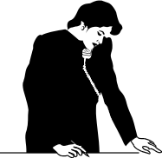



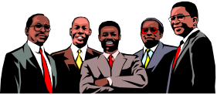
Job Function
Each job function has a set of views required to complete the job
Customers
CFO
Field Sales Rep
Forecasting
Opportunities
Orders
Channel Partners
Call Center Agent
Service Requests
Opportunities

Slide 5

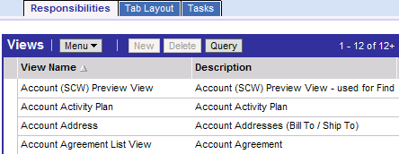
Responsibility
Is the set of views associated with a job function
Determines the views to which the employee has access
Is also assigned to all users of the application including
  Partner users
  Web customer users
Views associated with the Call Center Manager responsibility
Notes:
Defines a responsibility. Screen shot provides an example.
Navigate to Administration – Application > Responsibilities to demonstrate responsibilities in the Call Center application.

Slide 6


Views and Responsibilities
A view can be included in one or more responsibilities
Call Center Manager and Universal Agent responsibilities share a common set of views
Notes:
Different responsibilities can share a common set of views. Typically, two different responsibilities would not have the identical set of views in common.
Go over the student note on read-only views.
Another reason for using read-only views is to eliminate the need to create duplicate views and applets (students have not yet been introduced to applets).

Slide 7

Users and Responsibilities
Users can be assigned to one or more responsibilities
Alex West is assigned to both responsibilities: Call Center Manager and Universal Agent
Notes:
Emphasize the message in the callout.
Users can be assigned to multiple responsibilities, because they can have multiple job functions and require access to different sets of views based on those job functions.

Slide 8
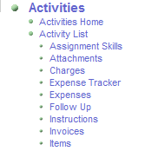
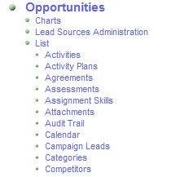
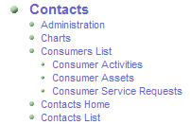

User Experience
Site Map shows the union of all screens and views for user’s assigned responsibilities
Notes:
This is a screen shot of a Siebel application Site Map to illustrate that users see the union of all views for all of their assigned responsibilities.

Slide 9
User Experience Continued
Application displays only a subset of all the accessible screen and view tabs
  Each responsibility has a set of screen and view tab layouts defined
  Subset improves user experience by highlighting the most commonly used screens and views
Users with multiple responsibilities see the default layout defined for their primary responsibility
Users can override these defaults to customize the layout using User Preferences
Notes:
Demo how to customize the tab layout. In the Site Map, navigate to User Preferences > Tab Layout.
Here is some information on Tab Layouts, if needed:
Prior to Siebel 7.5, a user's responsibility only determined the views to which users had access, and roles determined tab layout. Starting with Siebel 7.5, a new Tab Layout view has been added to the Application Administration screen making it easier for administrators to define default tab layouts for responsibilities. When users log in, they have full access to screens and views associated to each of their responsibilities. However, in the UI, they only see the tab layout defined for their primary responsibility. Remember, primary responsibility is typically defined by the administrator in the User Administration screen. By default, the first responsibility assigned to a user becomes the primary responsibility. In order for users to see a full list of screens and views associated to each of their responsibilities, they need to navigate to the Site Map. Users can modify their personal layout settings as defined by the application administrator. Users can change their tab layout in User Preferences. Any changes made by the user in User Preferences overrides tab layout at the responsibility level. Also, when a user navigates to a view via the Site Map, a tab for that view is temporarily added to the screen for that session.

Slide 10
References to Views
If a view is not included in a user’s responsibility:
  The view does not appear in the:
    Site Map
    Link bar
    Visibility filter
    View tabs
  Drilldown to the view is disabled
If a user does not have access to any of the views in a screen, the screen does not appear
  Screen tabs
  Site Map
Notes:
Users don’t have access to any views that are not associated with the user’s assigned responsibilities.

Slide 11
Review: Users, Views, and Responsibilities
Responsibilities determine the set of views to which a user has access
Views are associated with one or more responsibilities
Users are assigned to one or more responsibilities
A user sees the union of all associated views when he or she logs in
Notes:
This slide provides a review of all topics discussed up to this point in the module.

Slide 12
Summary
This module showed you how to:
  Describe the role of responsibilities
  Describe the relationships among views, users, and responsibilities
Notes:
Review Question: What do responsibilities determine?
Answer: Responsibilities determine the set of views to which a user has access.

Slide 13
Lab
In the lab you will:
  Explore responsibilities and views for different users
Notes:
See lab instructions for details.

